Slide 1


Extracting Insights from Biomedical Data using Topological Data Analysis
By Charlie Fractal
Mentor: Dr. Vignesh Subbian
College of Engineering | University of Arizona
NASA Space Grant Symposium
Tempe, Arizona
Arizona State University
April 22, 2017

Slide 2
The Problem
Data generated from clinical settings are often large, noisy, and multimodal.
Analyzing this data could lead to new discoveries to improve treatment for patients and/or prognosis of diseases.
Need methods for analyzing such large, high-dimensional, and noisy data sets.
Goal: Explore topological data analysis and use it on a real dataset.

Slide 3
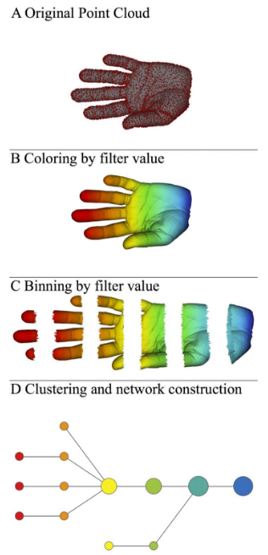
The Mapper Algorithm
Converts point cloud data into a 2D graph.
Mapper algorithm:
  Apply filter function
  Divide points into overlapping intervals
  Cluster each interval
  Clusters become nodes, and clusters with
  points in common are connected with edges
Image source: Lum, P.Y. et al. Extracting insights from the shape of complex data using topology. Sci. Rep. 3, 1236; DOI:10.1038/srep01236 (2013).
Notes:
Filter function: be anything, but is usually used to map each (potentially) high dimensional point to one dimension

Slide 4
Traumatic Brain Injury (TBI) dataset
A dataset of 834 patients with TBI, measuring labs over the first 3 days after injury. (Age range: 18-85, Mean: 39.51)
Glasgow Outcome Scale Extended (GOSE) measures the severity of disability, taken 6 months after the injury:
1 - Death 5 - Lower moderate disability
2 - Vegetative state 6 - Upper moderate disability
3 - Lower severe disability 7 - Lower good recovery
4 - Upper severe disability 8 - Upper good recovery
“Bad” outcome ^
“Good” outcome ^

Slide 5
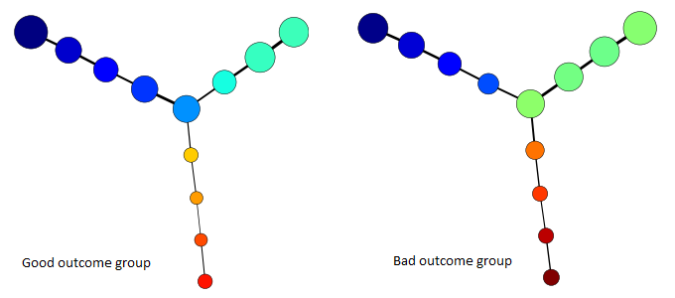
Using Mapper on the TBI Dataset
Filter function: Eccentricity (measures how close each point is to the ‘center’ of the data).
Colored by the average age of the patients in the node.
Software:
Python Mapper by Daniel Müllner
Low
High
Notes:
Bad outcome group: GOSE 1-4, Good outcome group: GOSE 5-8
-Flares corresponding to age
-Good group skewed younger
-Node size ~ number of points in node
-Node color ~ average filter value of points in node
-Edges thicker when there are more overlapping points
-Flares

Slide 6
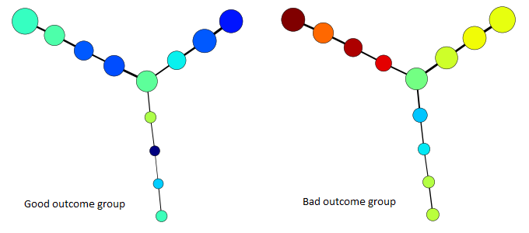
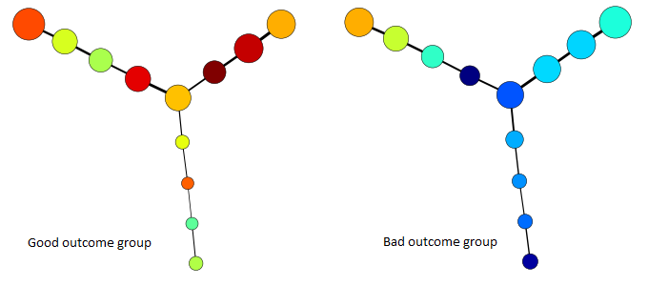
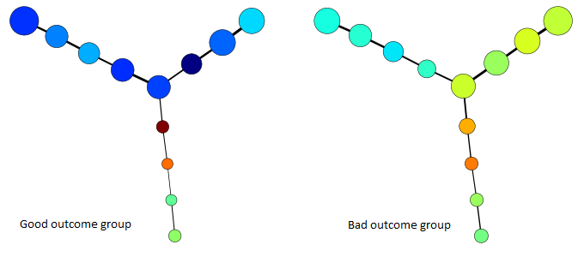
Most Significant Results
Low
High
Age
Sodium
Glucose
Hemoglobin
Notes:
-Highest sodium in young people who did bad
-Low sodium best indicator for younger-middle aged people

Slide 7
Summary of Results
Low age, sodium, chloride, glucose, and high hemoglobin in the first three days are correlated with better outcome.

Slide 8
Thank you!
Questions?

Slide 9
Software
Python Mapper by Daniel Müllner
http://danifold.net/mapper/

Slide 10
Topological Data Analysis (TDA)
Analyze complex, high-dimensional data by looking at its shape.
Goal: extract invariant topological features of the data to discover patterns and relationships.
Advantages of TDA:
  Deformation invariance
  Coordinate invariance
  Compressed representation
Notes:
-Deformation invariance: Stretched letter A still recognized as A. Benefit: Less sensitive to noise, able to find major features of underlying shape (loops).
-Coordinate invariance: No dependence on a coordinate system. Beneﬁt: able to analyze data collected from different platforms that may use different technologies.

Slide 11
Limitations of TDA
Based on visual inspection; imprecise.
Many different options of filter functions, number of intervals, clustering and covering methods; hard to know which is the best representation.
Good for exploratory analysis to be followed up by more traditional methods.

Slide 12
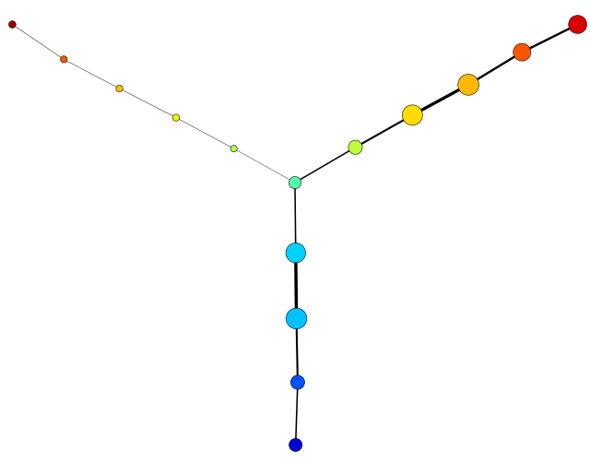
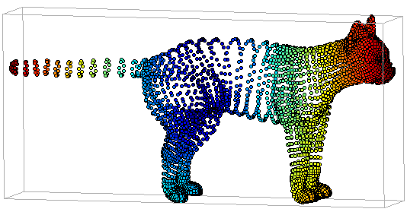
Mapper Example
Input: 3D points in the shape of a cat, with the points colored by their filter function value
(eccentricity with an exponent of infinity as the exponent)
Output: Mapper output for the cat dataset
(uniform cover method with 10 intervals, overlap of 50%, and first-gap cutoff with a gap size of 0.5), colored by filter function
Low
High
Notes:
Eccentricity: measures how close a point is to the ‘center’ of the dataset
Node size ~ number of points in node
Node color ~ average filter value of points in node
Edges thicker when there are more overlapping points
Flares
Hypothesis: upper left flare is tail

Slide 13
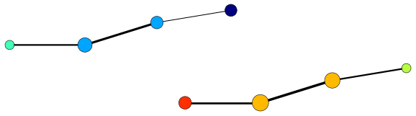
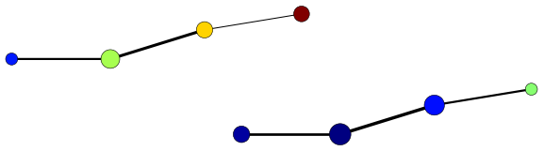
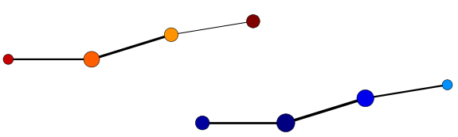
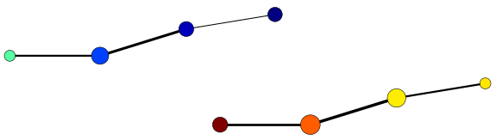
GOSE score as filter function
Colored by GOSE. Bottom group had better outcome, top group had worse outcome.
Colored by age
Colored by sodium
Colored by hemoglobin
Notes:
Also significant: chloride (highly correlated with sodium), glucose

